Slide 1

Meta Software development tools and environments :

Slide 2
Meta Software development tools and environments
1. Mercurial (hg) → Source control system used to manage code versions.
2. EdenSCM → Enhances Mercurial with scalable performance for large repositories.
3. VS Code @ Meta → Developer environment that interacts with EdenSCM for code editing.
4. Phabricator → Used for code review and collaboration, integrated with VS Code.
5. Buck2 → Build system triggered post-review for compiling code.
6. CMake → Generates build configurations used by Buck2.
7. LLVM/Clang → Compiles the code using configurations from CMake.
8. Gtest (googletest) → Runs unit tests on the compiled code.

Slide 3
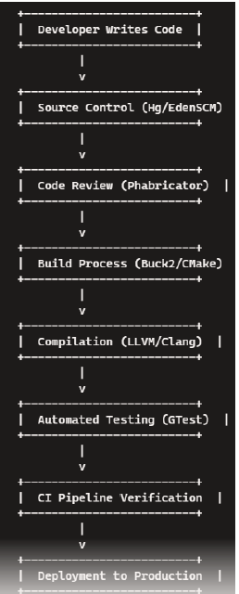
Sequence of Processes Build to Deployment

Slide 4
Mercurial (hg):
Mercurial (Hg) is a distributed source control management system similar to Git but designed for scalability and performance. It enables developers to efficiently track changes, collaborate, and manage large codebases. Meta uses custom internal extensions to enhance its functionality for large-scale projects.
Why Mercurial is Needed
Distributed Architecture:
Every developer has a full local repository (including entire history).
Enables offline work and reduces dependency on central servers.
Scalability:
Handles large repositories (e.g., Linux kernel, Mozilla) efficiently.
Optimized for projects with extensive histories and binary files.
Intuitive Workflow:
Simpler CLI syntax than Git for common operations.
Explicit branch management avoids accidental complexity.
Platform Agnostic:
Native support for Windows/Linux/macOS.
No reliance on POSIX shell environments.
Enterprise Features:
Built-in access control (hg.acl extension).
Audit trails with signed commits.
Concept | Description
Repository (repo) | A collection of tracked files and their revision history
Changeset | A snapshot of the project at a given time (a commit in Git)
Working Directory | Local copy of project files that can be modified
.hg Directory | Metadata directory storing history, settings, branches, etc.
Branch | A named line of development
Tag | A human-readable label for a specific changeset
Revision ID | A unique identifier (hash) for each changeset
Clone | A complete copy of a repository, including its full history
Pull / Push | Sync changes between repositories
Merge | Combine changes from different lines of development

Slide 5
Feature / Aspect | Git | Mercurial (hg)
Initial Release | 2005 | 2005
Creator | Linus Torvalds | Matt Mackall
Command Line Interface | Powerful but can be complex and inconsistent | Simpler, more consistent and user-friendly
Staging Area | Yes (index allows staging changes before commit) | No (commits all changes directly)
Branching Model | Lightweight, fast, and flexible | Heavier, more linear and structured
Performance | Excellent, especially for small to medium repos | Comparable, sometimes better for large repos
Learning Curve | Steeper due to complex commands and concepts | Gentler, easier for beginners
Tooling and Ecosystem | Vast ecosystem, widely supported | Smaller ecosystem, fewer third-party tools
Windows Support | Improved over time, now solid | Historically better on Windows
Extensibility | Good, but less modular | Very modular with native extension support
Popularity | Extremely popular and widely adopted | Niche, used by specific teams or legacy systems
Hosting Platforms | GitHub, GitLab, Bitbucket (Git) | Bitbucket (until 2020), Phabricator (legacy)
Community and Support | Large, active community | Smaller, less active
Use in Industry | Used by most open-source and enterprise projects | Used by some large companies (e.g., Facebook)

Slide 6
Why Teams Choose Mercurial Over Git
Simpler CLI: Consistent commands, no staging area confusion.
Immutable Changesets: Safer history, better traceability.
Scalable: Efficient with large monorepos (e.g., Facebook, Mozilla).
Extensible: Built-in support for plugins and custom workflows.
Centralized-Friendly: Easier SVN-like workflows.
Better Defaults: Fewer destructive operations, safer for teams.
Tooling: Strong IDE and CI/CD integration
Note ::
No explicit staging area like Git; changes go directly into a changeset.
.hg/ folder is central to all operations (like .git/ in Git).

Slide 7
Mercurial (hg) Core Command Reference
hg init` — Create a new repository.
hg clone [source] [dest]` — Clone a repository.
hg serve` — Start a web server for the repository.
hg status` — Show changed files in the working directory.
hg diff` — Show differences between revisions.
hg add [files]` — Add new files to version control.
hg remove [files]` — Remove files from version control.
hg rename old new` — Rename a file.
hg copy old new` — Copy a file.
hg commit -m "message"` — Commit changes.
hg rollback` — Undo the last transaction.
hg update [rev]` — Update working directory to a revision.
hg revert [files]` — Revert files to an earlier state.
hg log` — Show commit history.
hg tip` — Show the latest changeset.
hg annotate [file]` — Show who changed each line of a file.
hg branch [name]` — Create or switch to a branch.
hg branches` — List branches.
hg merge` — Merge another branch into the current one.
hg resolve` — Resolve merge conflicts.
hg pull` — Pull changes from another repository.
hg push` — Push changes to another repository.
hg incoming` — Show changesets not yet pulled.
hg outgoing` — Show changesets not yet pushed.
hg tag [name]` — Tag a revision.
hg tags` — List all tags.
hg bookmark [name]` — Create a bookmark (lightweight branch).
hg graft [rev]` — Copy changesets from another branch (cherry-pick).
hg backout [rev]` — Reverse a changeset.
hg bundle` / `hg unbundle` — Package and apply changesets.

Slide 8
EdenSCM
EdenSCM is a high-performance source control system designed to handle large-scale monorepos.
It was built to support Meta’s massive codebase, where traditional systems like Git struggled with performance and scalability.
Key Features
Scalability: Designed for repositories with millions of files and commits.
Performance: Fast operations due to lazy loading and efficient metadata handling.
Centralized Model: Clients fetch only what they need, reducing overhead.
Cross-Platform: Works on Linux, macOS, and Windows.
Git Compatibility: Through Sapling, developers can use Git-like commands.
Use Cases
- Massive Monorepos: Ideal for organizations like Meta, Google, or Microsoft.
- CI/CD Pipelines :: Speeds up CI jobs by reducing clone/checkout times.
- Developer Productivity :: Enables quick context switches between branches.

Slide 9
Architecture & Key Components
EdenSCM comprises three main components
eden CLI:
User-facing command tool, Mercurial-inspired (e.g., eden commit, eden update).
Enables Mercurial-style working operations—commit, update, branch, diff.
Mononoke (server-side):
Rust-based system managing repository data.
Enables on-demand fetch—clients download only what is needed, not the entire history .
EdenFS (virtual filesystem):
A FUSE-like layer that populates files only when accessed.
Provides sparse-checkout behavior transparently, with fast status queries and Watchman integration.
Provides lazy-loading of file content. Tracks file changes efficiently using Watchman for event-driven updates

Slide 10
EdenSCM vs Git vs Mercurial – Simplified Performance Comparison
Feature | EdenSCM | Git | Mercurial
Checkout Speed | Instant (loads only used files) | Slower (downloads all files) | Slower (downloads all files)
Disk Usage | Smart — only stores needed files | High — stores everything | High — stores everything
Clone Time | Fast (just metadata) | Slower (clones entire repo) | Slower
File Access | On demand (lazy loading) | Immediate (everything is present) | Same
Merge Handling | Good for known branches | Powerful, but messy history possible | Clean & simple merges
Scaling to Large Repos | Built for scale | Needs tooling help | Better, but not optimized
Storage System | Mononoke backend | Local .git/ folder | Local .hg/ folder

Slide 11
Common EdenSCM - Sapling /Daily Commands
eden clone <repo> – Clone a repository.
eden checkout <branch> – Checkout a branch.
eden status – Show working directory status.
eden diff – Show changes.
eden commit -m "message" – Commit changes.
eden update – Update to the latest revision.
eden branch – List or create branches.
eden merge <branch> – Merge another branch.
eden rebase – Rebase current branch.
eden pull – Pull latest changes from the server.
eden push – Push local commits to the server.
eden clean – Remove untracked files.
eden revert <file> – Revert changes in a file.
eden log – View commit history.
eden blame <file> – Show who last modified each line.

Slide 12
Buck2
Buck2 is a build system — a tool used to compile code, build binaries, and run tests efficiently, especially in large and complex software projects. It was developed by Meta (Facebook) to scale and speed up builds across their massive codebase.
Task | Example
Compiling source code | Compiling C++, Rust, Java, Python, etc. into binaries or libraries
Managing dependencies | Only rebuilding what changed instead of everything
Testing automation | Running unit/integration tests as part of the build
Remote execution | Sending build tasks to fast remote servers (for speed)
Caching | Reusing previous build outputs to avoid redundant work
Hermetic builds | Ensures builds are reproducible and consistent on all machines
A large monorepo (millions of files)
Multiple languages (e.g. Python, Java, Rust, C++)
Need fast incremental builds
Require reliable, reproducible builds
Want to run builds in the cloud or parallelized environments

Slide 13
Buck2
Real-World Example Workflow
Clone the monorepo
Create BUCK file with java_binary()
Build with buck2 build //app:my_app
Run with buck2 run //app:my_app
Add tests → buck2 test //app:test_suite
Push → CI runs buck2 test and buck2 build
Command | Description
buck2 build //path:target | Build a specified target
buck2 run //path:target | Build and run the target
buck2 test //path:test_target | Run unit or integration tests
buck2 query | Query dependency graphs
buck2 uquery | Use unconfigured query (similar to Bazel's cquery)
buck2 clean | Clean output cache
buck2 targets | List all buildable targets
buck2 audit | Inspect build rules and configurations
buck2 init | Set up a new Buck2 workspace

Slide 14
Cmake
CMake is an open-source build system generator. It doesn’t build software itself, but generates native build files (like Makefiles, Ninja, Visual Studio projects) for various platforms and compilers from a single configuration file (CMakeLists.txt).
Developers write CMakeLists.txt once, and CMake generates platform-specific build files.
CMake is a meta-build tool: It creates build scripts for tools like Make/Ninja. Make/Ninja are build executors that run those scripts."
Workflow Using CMakeLists.txt
cmake .. → Uses CMakeLists.txt to generate native build files.
make (or chosen generator) → Builds the defined targets.
# Example:
mkdir build
cd build
cmake ..
make

Slide 15
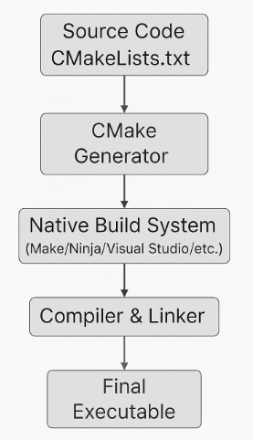
Cmake
The CMakeLists.txt file is CMake’s project manifest that contains directives and instructions CMake uses to generate native build tools like Makefiles, Ninja, or Visual Studio project files.
Function | Explanation
Define build targets | Specifies executables, libraries, and other build outputs.
Handle dependencies | Declares internal (source files) and external (packages) dependencies.
Set compiler options | Adds flags for compilers, linkers, and preprocessor defines.
Specify include paths | Tells the compiler where to look for header files.
Installation rules | Defines how and where to install build products.
Testing setup | Enables test discovery and integration with CTest.
Cross-platform logic | Contains conditional logic for platform/toolchain-specific behaviors.
Packaging | Integrates with tools like CPack for generating installers.

Slide 16
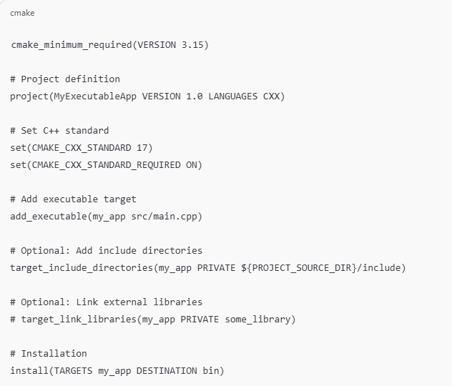
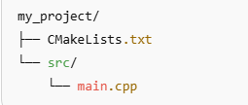
Cmake
CMakeLists.txt (for Executable)
Sample for Executable Project
Project structure:

Slide 17
1 | Mercurial (hg): | https://www.mercurial-scm.org/guide
2 | Buck2: | https://buck2.build/docs/about/getting_started/
3 | VS Code @ Meta:
4 | Phabricator: | https://releases.llvm.org/17.0.1/docs/Phabricator.html
5 | EdenSCM: | https://github.com/bergwolf/eden
6 | CMake: | https://cmake.org/cmake/help/latest/manual/cmake-commands.7.html
7 | LLVM/Clang: | https://clang.llvm.org/docs/ClangCommandLineReference.html
8 | Gtest (googletest) | https://google.github.io/googletest/
9 | Gcov | Gcov (Using the GNU Compiler Collection (GCC))

Slide 18
LLVM/Clang
LLVM (Low-Level Virtual Machine) is a modular, reusable compiler infrastructure designed for compile-time, link-time,
run-time, and idle-time optimization of programs.
It is not just a virtual machine—it’s a toolchain and backend framework for building compilers, code analyzers, debuggers, and JIT engines.
Clang is a C, C++, and Objective-C front end for LLVM. It parses source code and generates LLVM Intermediate Representation (IR).
Clang is designed to be:
Fast
Modular
User-friendly with GCC-compatible flags
Better diagnostics and tooling support

Slide 19
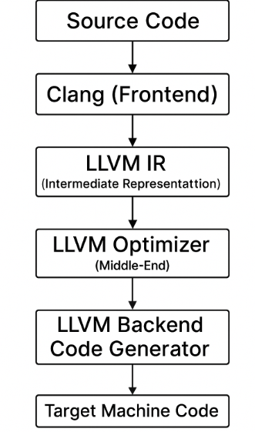
LLVM Key Components
Component | Description
Clang | C/C++/Obj-C frontend → LLVM IR
LLVM IR | Language-independent intermediate code
opt | LLVM Optimizer: applies IR-level optimizations
llc | Converts LLVM IR to machine code
clang++ | Compiles C++ using Clang frontend and LLVM backend
llvm-as/llc | Assembler/Disassembler for LLVM IR
libclang | C API for tooling
clangd | Language server for IDE tooling
LLVM Passes | Optimization passes (inline, loop unroll, etc.)

Slide 20
Compare Clang with GCC
Aspect | Clang (LLVM) | GCC
Architecture | Modular (frontend + optimizer + backend) | Monolithic
Compile Speed | 1.5–2× faster (avg.) | Slower
Memory Usage | Lower footprint | Higher (especially for templates)
Diagnostics | Clear, colorized, actionable errors | Less user-friendly
Sanitizers | ASan, UBSan, TSan, MSan | Limited support
License | Apache 2.0 (business-friendly) | GPL (copyleft)
C++ Standards | Faster adoption of C++20/23 | Slower to implement new features
Debug Info | Better DWARF5 support (GDB, LLDB) | Mature but less optimized

Slide 21
Common Clang/LLVM Commands
Purpose | Command
Compile C file | clang main.c -o main
Compile C++ file | clang++ main.cpp -o main
Compile with optimization | clang -O2 main.c -o main
Generate LLVM IR | clang -S -emit-llvm main.c -o main.ll
Static code analysis | clang-tidy main.c -- -I./include
Code formatting | clang-format -i main.c
Compile with sanitizer | clang -fsanitize=address main.c -o main
Dump AST | clang -Xclang -ast-dump -fsyntax-only main.c
Disassemble LLVM IR | llvm-dis main.bc
Compile IR to object | llc main.ll -o main.o
Link object | clang main.o -o main
Convert ELF to binary | llvm-objcopy -O binary main.elf main.bin

Slide 22
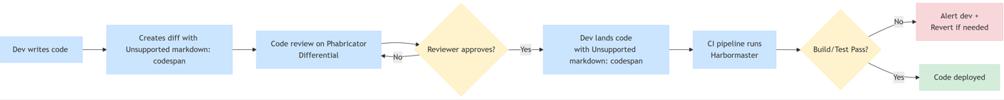
--install
Phabricator
Phabricator is an open-source, web-based suite of tools for peer code review, project management, and code repository browsing, originally developed by Facebook. It helps software teams collaborate efficiently during development, especially for large-scale and long-term projects.
Peer Code Review
Ensures code quality, readability, and functional correctness.
. Change Tracking
Maintains a full history of changes, decisions, and review feedback.
Unified Toolset
Combines code review, repository management, bug tracking, task tracking, and CI integrations into a single interface.
Phabricator-based development workflow

Slide 23
--install
Core Components & Use Cases
1. Code Review (Differential)
Central tool for reviewing and approving code changes.
Supports inline comments, revision history, and reviewer workflows.
Integrates with Git, Mercurial, and Subversion.
5. Access Control & Audit
Fine-grained permissions and policies.
Supports auditing of commits and code changes.
Useful for compliance and secure development.
2. Task Management (Maniphest)
Lightweight issue and bug tracking system.
Supports custom fields, priorities, and project tagging.
Integrates with commits and code reviews.
6. Developer Tools
Arcanist (arc): CLI tool for interacting with Phabricator.
Used for submitting diffs, running lint/tests, and managing workflows.
. Build & CI Integration (Harbormaster)
Automates builds and test pipelines.
Can trigger builds on code review or commit.
Integrates with external CI tools.
8. Unified Interface
All tools are integrated into a single web UI.
Enables seamless navigation between code, tasks, and discussions.

Slide 24
Core Arcanist (arc) Commands
Code Review & Submission
arc diff — Create or update a Differential revision (code review).
arc amend — Amend the commit message with revision info.
arc land — Land a revision (merge and close it).
arc patch — Apply a revision or diff to your working copy.
Review & Revision Management
arc list — Show revisions associated with your working copy.
arc browse — Open a revision or file in the web UI.
arc close-revision — Manually close a revision.
Linting & Testing
arc lint — Run configured linters on your code.
arc unit — Run unit tests.
arc cover — Show code coverage information.
Utilities
arc help — Show help for commands.
arc which — Show which revision is associated with the current branch.
arc install-certificate — Authenticate your machine with Phabricator.
arc alias — Create custom command aliases.

Slide 25
Core Arcanist (arc) Commands
Code Review & Submission
arc diff — Create or update a Differential revision (code review).
arc amend — Amend the commit message with revision info.
arc land — Land a revision (merge and close it).
arc patch — Apply a revision or diff to your working copy.
Review & Revision Management
arc list — Show revisions associated with your working copy.
arc browse — Open a revision or file in the web UI.
arc close-revision — Manually close a revision.
Linting & Testing
arc lint — Run configured linters on your code.
arc unit — Run unit tests.
arc cover — Show code coverage information.
Utilities
arc help — Show help for commands.
arc which — Show which revision is associated with the current branch.
arc install-certificate — Authenticate your machine with Phabricator.
arc alias — Create custom command aliases.

